Slide 1
Chatbot Observations n Inputs
SmartKarrot

Slide 2
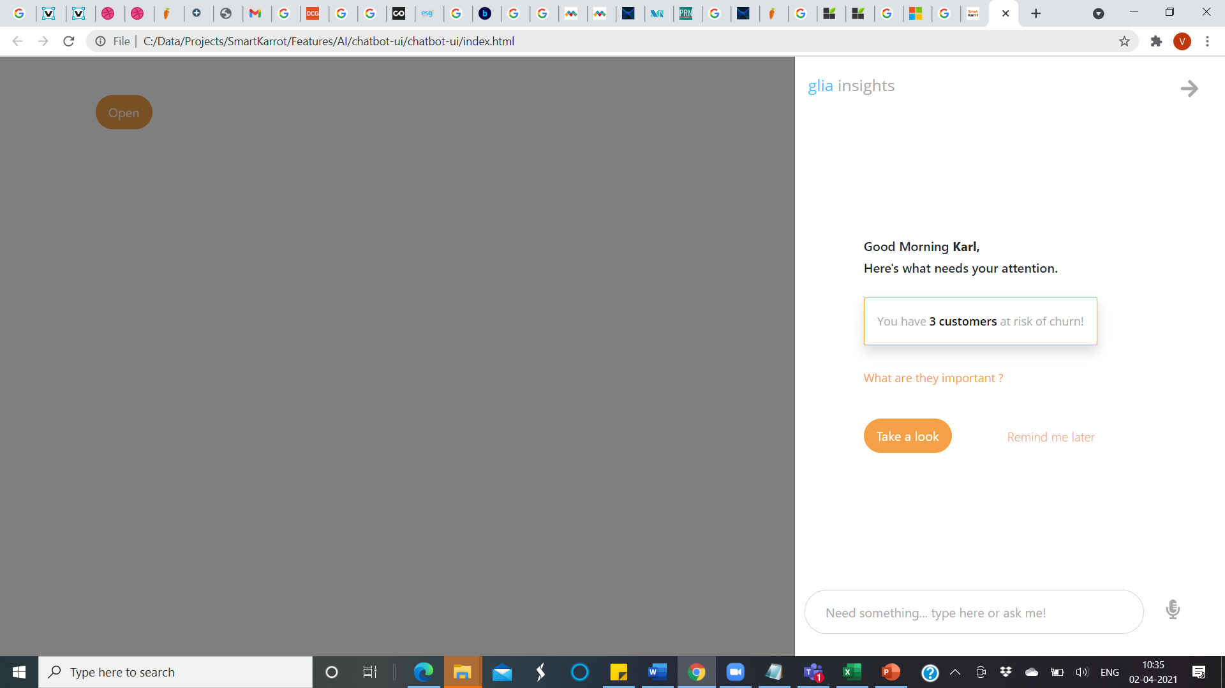
Chatbot - Feedback
Let this be a DIV with a fixed width box (till the red line). If there is additional text let it wrap below. Lets also make the light gray text a little darker
Let this also be a hyper link
After typing if you hit enter let it go to the next page (take-a-look.html)

Slide 3
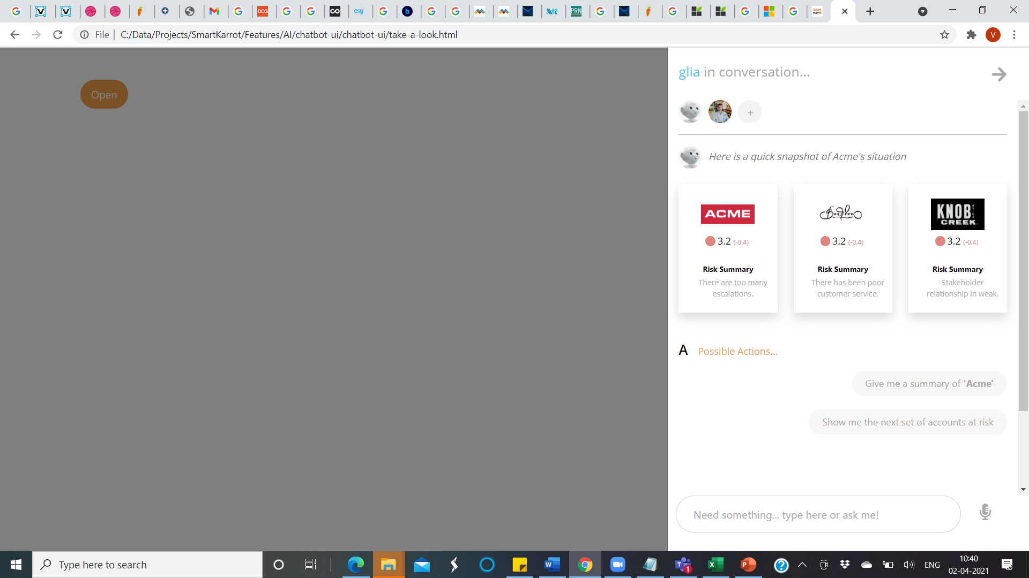
If this text increases let it align to the red line.
Chatbot - Feedback
Let this text get truncated after a few characters (followed by …) so it does not break the design
Can you vertically align this text to the ‘A’ icon. Also use the ‘A’ icon attached
Have all links show up as a ‘hand’ icon

Slide 4
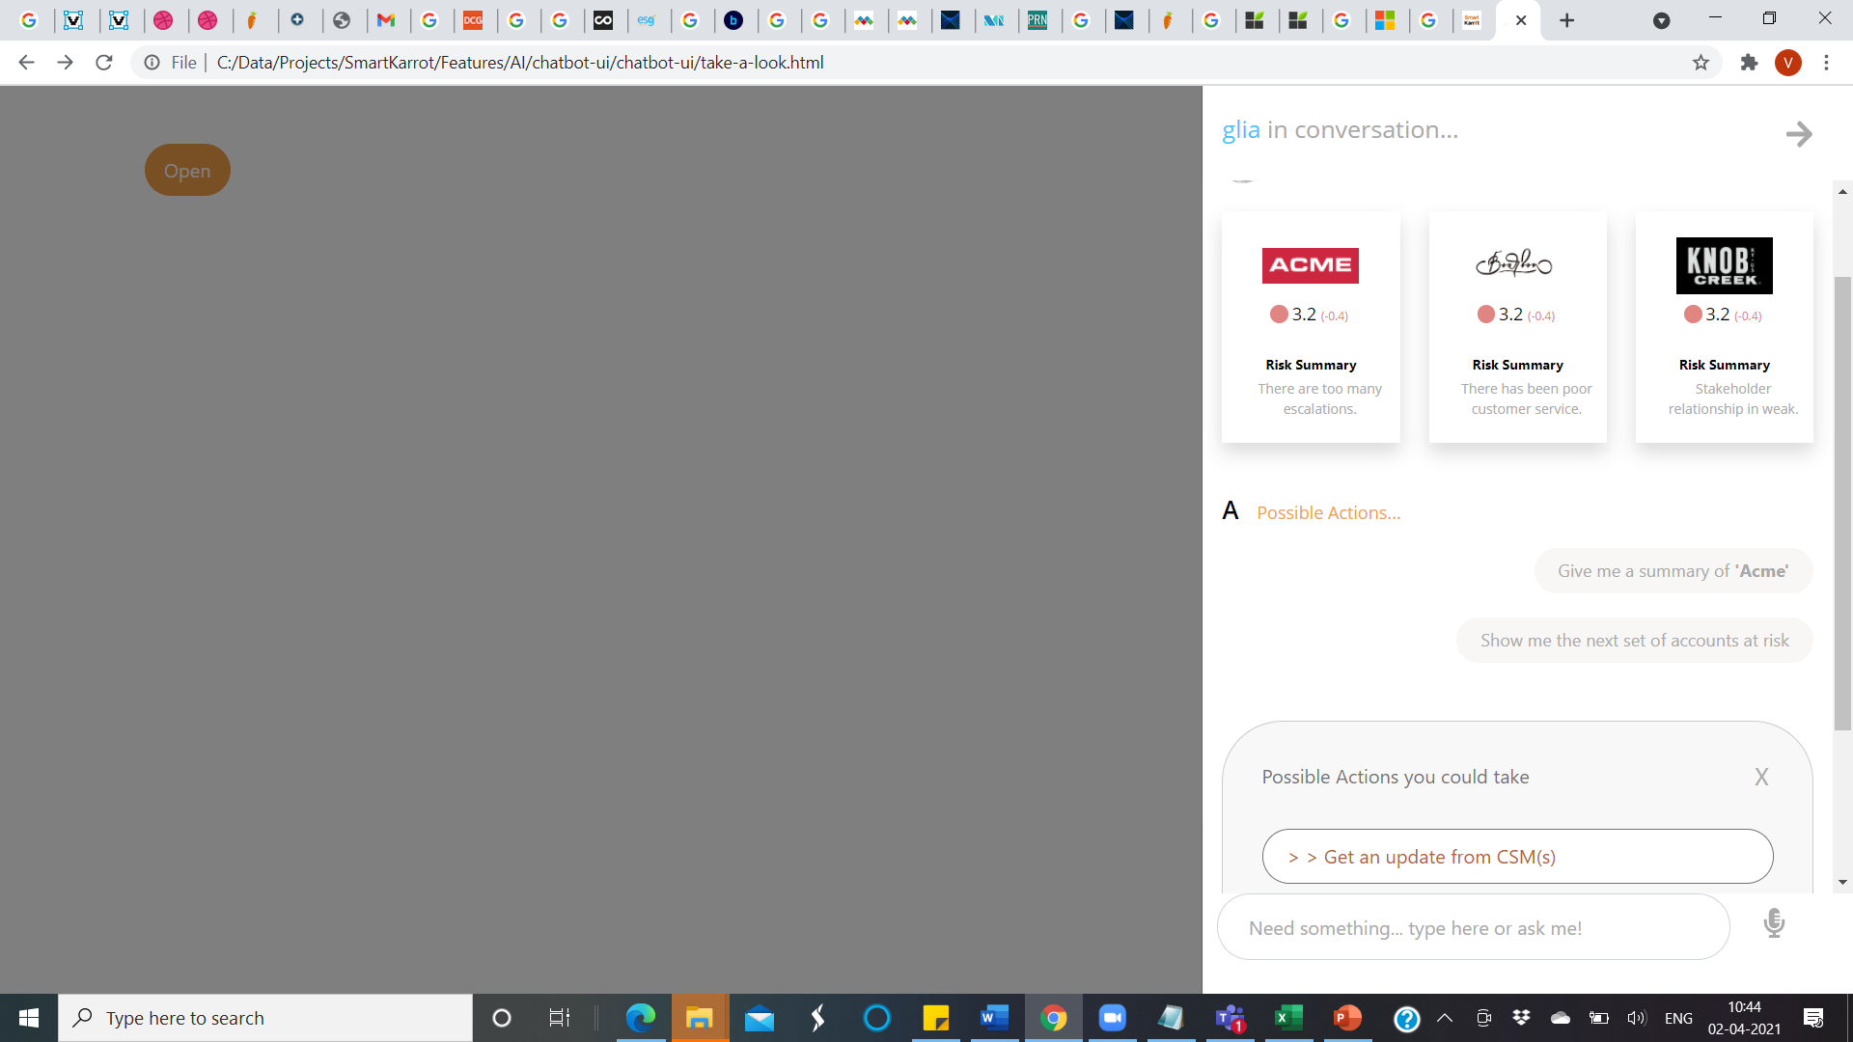
Chatbot - Feedback
As discussed see if this can come above all the information
This needs to link to the page: action-requested.html. Can you also check the links here.. They are different as shown in the design

Slide 5
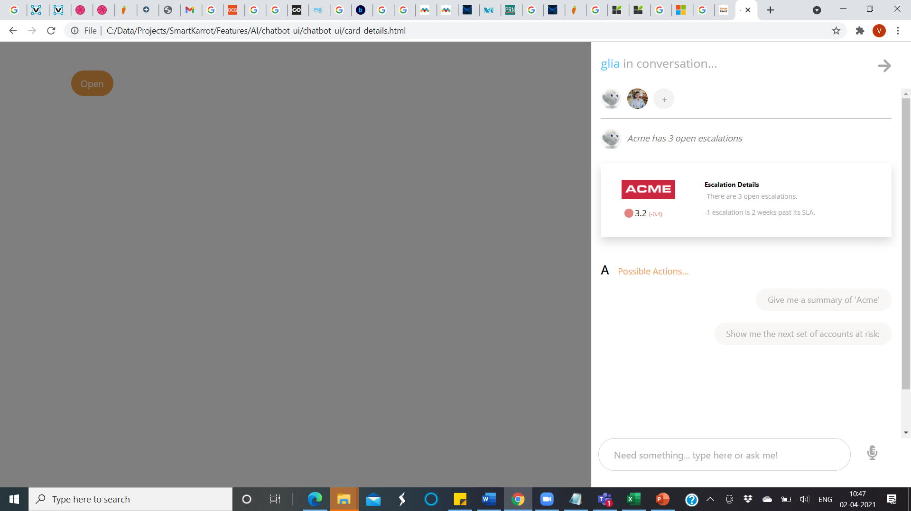
If this text increases let it align to the red line and extend down and not break the design
Chatbot - Feedback

